Slide 1





Department of Computer Science and Engineering
AGRI
COMPANION
USING MACHINE LEARNING
BATCH: A2
DHARSHINI B (2019PECCS116)
DHARSHINI PK (2019PECCS117)
KARTHIKA M (2019PECCS124)
GUIDE NAME: SATHIYA . V
Associate Professor
CO-ORDINATOR NAME: Dr. KAVITHA SUBRAMANI-M.E., Phd,
PROFESSOR

Slide 2

With the help of the online application Agri-Companion, farmers will be able to increase agricultural productivity, minimize soil erosion on cultivated land, use fewer chemicals to produce crops, and make the most of available water resources. The random forest algorithm is used to estimate agricultural productivity and determine product costs using temporal information. The acquired meteorological data has been extensively used to suggest the appropriate crops that the farmers should choose under the given soil and climatic conditions. Due to seasonal climatic variations as well as the importance of essential elements like soil, water, and air, the use of different fertilizers is similarly unpredictable. Agricultural yields are steadily declining in this setting. Offering farmers, a user-friendly recommender system is the problem's answer. A model is presented that takes these issues into account. The suggested methodology enables crop selection based on environmental and economic criteria in an effort to increase crop yields and meet the nation's rising food demand. Variables including rainfall, temperature, humidity, soil nutrients, and soil pH are analyzed and the suggested model forecasts crop production. Farmers are able to detect diseases in their plants and regulate the soil's nutrient level thanks to a web application. The accuracy obtained for the crop detection model is 98.4% and for the disease detection model an accuracy of 99.2% is achieved.
ABSTRACT

Slide 3
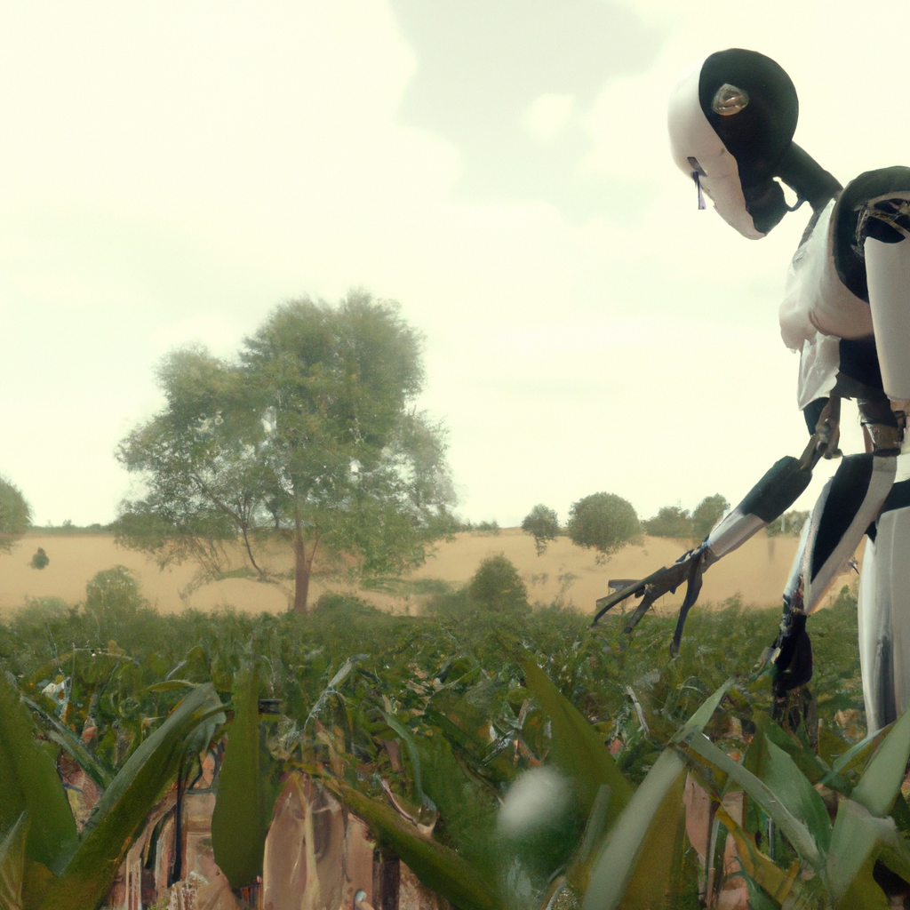

OBJECTIVE
The objective is to recommend the optimum crop, based on the factors such as soil pH, humidity, temperature, rainfall, and inputs such as Nitrogen(N), Phosphorus(P), and Potassium (K). It accurately predicts the crop the can be grown, fertilizers and plant disease of numerous crops in India, such as Rice, Maize, Chickpeas, Kidney Beans, Black gram, lentil, pomegranate, banana, mango, grapes, watermelon, musk melon, apple, orange, papaya, coconut, cotton, jute and coffee crops. Using a variety of supervised machine learning techniques, the crop that will be the most profitable and fertilizers that can be used to improve the crop yield are suggested, and the diseases that have affected the plants are identified. The dataset contains a wide range of variables, such as soil pH, soil moisture, Nitrogen (N), Phosphorus (P), and Potassium (K) . The suggested system employed a number of machine learning techniques, including RESNET9 and Random Forest.

Slide 4

LITERATURE SURVEY
YEAR | AUTHOR NAME | PAPER DETAILS | METHODOLOGY | MERITS & DEMERITS | FUTURE SCOPE
2020 | Abhinav Sharma, Arpit Jain, Prateek Gupta and Vinay Choudary. | Title: Machine Learning application for precision agriculture. Issue date: 31 Dec 2020. Published in: IEEE Access Volume: 9 | ML with Computer vision are reviewed for the classification of a different set of crop images in order to maintain the crop quality and yield assessment. Crop prediction: Deep CNNs-AlexNet and GoogLeNet. Disease and weed prediction: CNN-GoogLeNet algorithm based Inception v3 in Tensor Flow. | Merits: 1. Parameter variation – the crop yield depends on a lot of parameters and the AI systems handle the parameters dependency efficiently. 2. Easy configuration – with CNN, designing a disease/weed detection system is not a complex job unlike other systems. Demerits: The accuracy of prediction depends on the quality of training dataset which may be applicable to only a limited number of crops. | In large agriculture fields UAV swarm can be utilized for near real time field monitoring through computer vision and DL algorithms and accordingly swarm of UAV can be used for spraying of pesticides and fertilizers in the infected crops.

Slide 5
YEAR | AUTHOR NAME | PAPER DETAILS | METHODOLOGY | MERITS & DEMERITS | FUTURE SCOPE
2021 | Dayalini S, Sathana M, Navodya P.R.N, Narmada Gamage, Anuradha Jaya | Title: Agro-Mate: A Virtual Assister to Maximize Crop Yield in Agriculture Sector Issue date: 10th Dec 2021 Published in: IEEE Region10Conference(TENCON) | Rice disease prediction with recommendation: Using CNN (Convolutional Neural Network) for image classification. Flood and drought prediction: The random forest algorithm is used to predict the occurrence of flood. | Merits: 1.Around 95% accuracy is obtained 2.With use of IOT real time data from agricultural fields is used as inputs for prediction Demerits: Failures in forecasting temperature, rainfall, soli conditions, disaster management, and disease control all have an impact. | This solution is currently designed for the Western province that belongs to wet zone low country of Sri Lanka which can be further extended to the other provinces and ecological regions.

Slide 6
YEAR | AUTHOR NAME | PAPER DETAILS | METHODOLOGY | MERITS & DEMERITS | FUTURE SCOPE
2022 | Sanidhya Purohit, Deep Sanghani. Naman Senjaliya, Prof. Anuradha Kapoor | Title: Agro-Farm Care for Crop, Fertilizer & Disease Prediction using Machine Learning Issue date: 03 March 2022 Published in: International Research Journal of Engineering & Technology Volume: 09 | Developing a user-friendly web-based system for farmers By providing their soil details like nitrogen,phosphorus, potassium, pH level farmer gets the idea of which crop is best for their soil. By providing an image of leaf farmer gets an idea which disease caught their crop and they also suggest how you can prevent it. | Merits: It contains several models that describe which crop be grown based on different conditions, it also suggests fertilizers be used also the other feature is that it can detect the disease Demerits: Overtraining the model may result in a sensitive prediction system. | Building a Website can be built to help farmers by uploading an image of farms. Crop diseases detection uses image processing in which users get pesticides based on disease images Fertilizer prediction based on soil condition.

Slide 7
YEAR | AUTHOR NAME | PAPER DETAILS | METHODOLOGY | MERITS & DEMERITS | FUTURE SCOPE
2022 | Priyanka Sahu, Amit Prakash Singh, Anuradha chug, Dinesh Singh | Title: A Case Study of Banana Crop using Machine Learning Issue date: 18 August 2022 Published in: IEEE Region10 Conference(TENCON) | Disease detection Gabor filter and the 2D log Gabor filter have been combined to create an upgraded Gabor filter that retrieves characteristics from diseased plant images. Furthermore, the KNN classifier is utilized to classify the present diseases | Merits: It provided an image processing algorithm for detecting and calculating defect regions on banana leaves. Demerits While capturing the images of fruits or leaves, only one direction is considered, but more angles need to cover up during the image acquisition. | To accomplish more and more exactness in the prediction, different forms of neural networks were utilized. The utilization of evolutionary algorithm techniques and join them with different fields

Slide 8
YEARC | AUTHOR NAME | PAPER DETAILS | METHODOLOGY | MERITS & DEMERITS | FUTURE SCOPE
2022 | Arfat Ahmad khan, Muhammad Faheem, Rab Nawaz Bashir, Muhammad Zahid Abbas | Title: IOT Assisted Context Aware Fertilizer Recommendation Issue date: 09 Dec Published in: IEEE Access Volume: 10 | The performance of the Logistic Regression (LR), SVM, KNN, and GNB models used for the fertilizer recommendation system. Apple disease prediction model is also proposed using data analytics, machine learning, and IoT. | Merits: 1. The efficient application of fertilizers can save resources as well as prevents soil deterioration. 2.The soil nutrients are assessed by colorimetry and machine learning model with Gaussian Process Regression (GPR). Demerits: Due to the availability of limited datasets, the deep neural network was not applicable. | The evaluation of the proposed model for fertilizer recommendation reveals that GNB was the most accurate machine learning model with accuracies of 96% and 94% for training and test datasets. The addition of a new dataset with a deep learning application can be a good contribution in the future.

Slide 9
YEAR | AUTHOR NAME | PAPER DETAILS | METHODOLOGY | MERITS & DEMERITS | FUTURE SCOPE
2021 | PE Rubini, P Kavitha. | Title: Deep Learning model for early prediction of plant disease Issue date: 4th February 2021 Published in: 2021 Third International Conference on Intelligent Communication Technologies and Virtual Mobile Networks (ICICV) | In this VGG 16 and DenseNet architecture were implemented and the results are analyzed with the same dataset. The dataset taken for implementation is the Plant Village dataset which contains 17000 training images and 200 testing images. | Merits: The DenseNet architecture proves better accuracy than VGG16 because of its more diversified features. Demerits The main drawback of VGG-16 is its fully connected nodes and is over 533MB. This makes deploying VGG a tiresome task. | The dataset used here includes only one type of plant to detect the type of disease. In addition to this, we can include different varieties of plant species and train the model to detect different kinds of plant diseases.

Slide 10
YEAR | AUTHOR NAME | PAPER DETAILS | METHODOLOGY | MERITS & DEMERITS | FUTURE SCOPE
2021 | Sri Laasya. Kanuru, Amit Kumar Tyagi, Aswathy S U N Sreenath, Terrance Frederick Fernandez, Shashvi Mishra | Title: Prediction of Pesticides and Fertilizers using Machine Learning and Internet of Things Issue date: 27 Jan Published in:2021 International Conference on Computer Communication and Informatics (ICCCI ) | The yield relies upon whether k-NN is utilized for characterization or relapse. Naive Bayes is useful to build models and especially for very large data sets. The purpose of the support vector machine algorithm is to find a hyperplane in the n-dimensional space that uniquely classifies the data points. | Merits: 1.Obtaining viable correlation between soil type and chemicals used. 2. Blockchain is used for secure communication made among Internet of Things device in agriculture sector. Demerits: The administration has restricted a few pesticides while the utilization of others has been managed. | Future work could include enabling IoT technology in order to get accurate data using a GPS module and relay the prediction of fertilizer type to the farmer in a cost efficient way through the cloud. It could also include the usage of blockchain technology in agriculture in order to increase optimization efficiency.

Slide 11
YEAR | AUTHOR NAME | PAPER DETAILS | METHODOLOGY | MERITS & DEMERITS | FUTURE SCOPE
2021 | Anguraj.K, Thiyaneswaran.B, Megashree. G, Preetha Shri.J.G, Navya.S, Jayanthi.J | Title: Crop Recommendation on Analyzing Soil using Machine Learning Issue date: 5th April 2021 Published in: Turkish Journal of Computer and Mathematics Education Volume: 12 | Prediction model is trained using Random Forest and Naïve Bayes algorithms. | Merits: The use of Random Forest makes the model handle large datasets with high dimensionality. It prevents overfitting issue by enhancing the accuracy of the model. Demerits: It is a difficult tradeoff between the training time (and space) and increased number of trees. | The dataset used here includes only one type of plant to detect the type of disease. We can include different varieties of plant species and train the model to detect different kinds of plant diseases.

Slide 12
YEAR | AUTHOR NAME | PAPER DETAILS | METHODOLOGY | MERITS & DEMERITS | FUTURE SCOPE
2022 | Taranjeet Singh, Saurabh Anand, Anmol Sehgal, Siddhesh Mahajan, Prof. Pranoti Kavimandan | Title: CROFED - Crop and Fertilizer Recommendation and Disease diagnosis system using Machine Learning and Internet of Things. Issue date: July 2022 Publishe in: IIJRT Volume: 9 | For pH the hydrogen-ion in the soil is measured using a PH meter, an electric instrument. The crop is predicted using a machine learning model called XG Boost. | Merits: High accuracy because of XG Boost algorithm Demerits: Due to the availability of limited datasets, the deep neural network was not applicable. | The device can also help farmers calculate crop MSP. The disease detection feature can also be improved by adding dedicated cameras to the device, which will improve the device’s accuracy even further.

Slide 13
YEAR | AUTHOR NAME | PAPER DETAILS | METHODOLOGY | MERITS & DEMERITS | FUTURE SCOPE
2022 | C. Murugamani, S.Shitharth, S.Hemalatha, Pravin R.Kshirsagar, K.Riyazuddin, Quadri Noorulhasan Naveed, Saiful Islam, Syed Parween Mazher Ali, & Areda Batu | Title: Machine Learning Technique for Precision Agriculture Applications in 5G-Based Internet of Things Issue date: 7 June 2022 Published in: Wireless Communications and Mobile Computing Volume 2022 | Irrigation Management System-WSNs are used as the organizing mechanism in this respect. Pest and Disease Control. A WSN can observe these occurrences independently and can anticipate them in a field of interest. | Merits: Different aspects of the infected sheet may precisely identify and classify different plant diseases by removing features of the infected sheet. This method enables the illness to be detected and pesticides sprayed automatically on the afflicted plants and to send the user information. Demerits: Overtraining the model may result in a sensitive prediction system. | In the future, this presented work is improved with the CNN model for classifying diseases.

Slide 14



PROBLEM STATEMENT
AGRICULTURE HAS A VITAL ROLE IN OUR DAILY LIFE. CONVENTIONAL METHODS OF FARMING HAS HELPED US A LOT OF YEARS BUT WITH THE CLIMATE CHANGE AND THE DECREASING AMOUNT OF RESOURCES, WE NEED TO IMPLEMENT CERTAIN METHODOLOGIES IN ORDER TO IMPROVE THE YIELD AND REDUCE THE AMOUNT OF RESOURCES USED.
FARMERS ARE ALSO UNABLE TO DETECT CROP DISEASES DUE TO A LACK OF KNOWLEDGE AND OLD PRACTICES, WHICH OFTEN RESULT IN SOIL NUTRIENT DETERIORATION AND EXHAUSTION. AS A RESULT, CROP FAILURE OCCURS.
GROWING ONLY CERTAIN CROPS DEPLETES THE SOIL, HENCE FARMERS CAN ANALYSE THE SOIL NUTRIENTS AND GAIN KNOWLEDGE ABOUT WHICH CROPS CAN BE GROWN FOR THEIR SOIL COMPOSITION AND FOR WHICH CLIMATIC CONDITION.

Slide 15

THE PROPOSED SYSTEM MAKES PREDICTIONS ABOUT THE CROPS THAT MAY BE PLANTED AND WOULD PRODUCE A HIGH YIELD BASED ON THE NUTRIENT MAKEUP OF THE SOIL AND THE NPK RATIO AND THE ENVIRONMENTAL CONDITIONS. EVERY SOIL DIFFERS IN ITS MAKEUP OF MACRONUTRIENTS AND MICRONUTRIENTS.
THE TYPE OF CROP THAT CAN BE PRODUCED AND THE KIND OF FERTILIZER THAT CAN BE USED TO IMPROVE THE SOIL ARE PREDICTED USING THIS ANALYSIS.
THE APPLICATION HAS ALSO BEEN CREATED SO THAT USERS CAN UPLOAD PICTURES OF DISEASED PLANT LEAVES IN ORDER TO FORECAST THE ILLNESS AND SUGGEST TREATMENT OPTIONS. ​​
PROPOSED SYSTEM
THE PROPOSED SYSTEM HAS THE FOLLOWING MODULES:
CROP PREDICTION AND RECOMMENDATION BASED ON SOIL PARAMETERS
FERTILIZER PREDICTION AND RECOMMENDATION BASED ON SOIL PARAMETERS
DISEASE IDENTIFICATION IN CROPS AND PREVENTIVE MEASURES RECOMMENDATION.

Slide 16
TECHNOLOGY STACK
SOFTWARE REQUIREMENTS
HARDWARE REQUIREMENTS
OPERATING SYSTEM : WINDOWS 10
Tool : Jupyter Notebook
Libraries : Pandas,
Numpy,
Matplot,
Scikit Learn
Frameworks : Flask, Torch
API : Open Weather App
PROCESSOR : INTEL I3
Hard disk : 10 GB
RAM : 4 GB

Slide 17
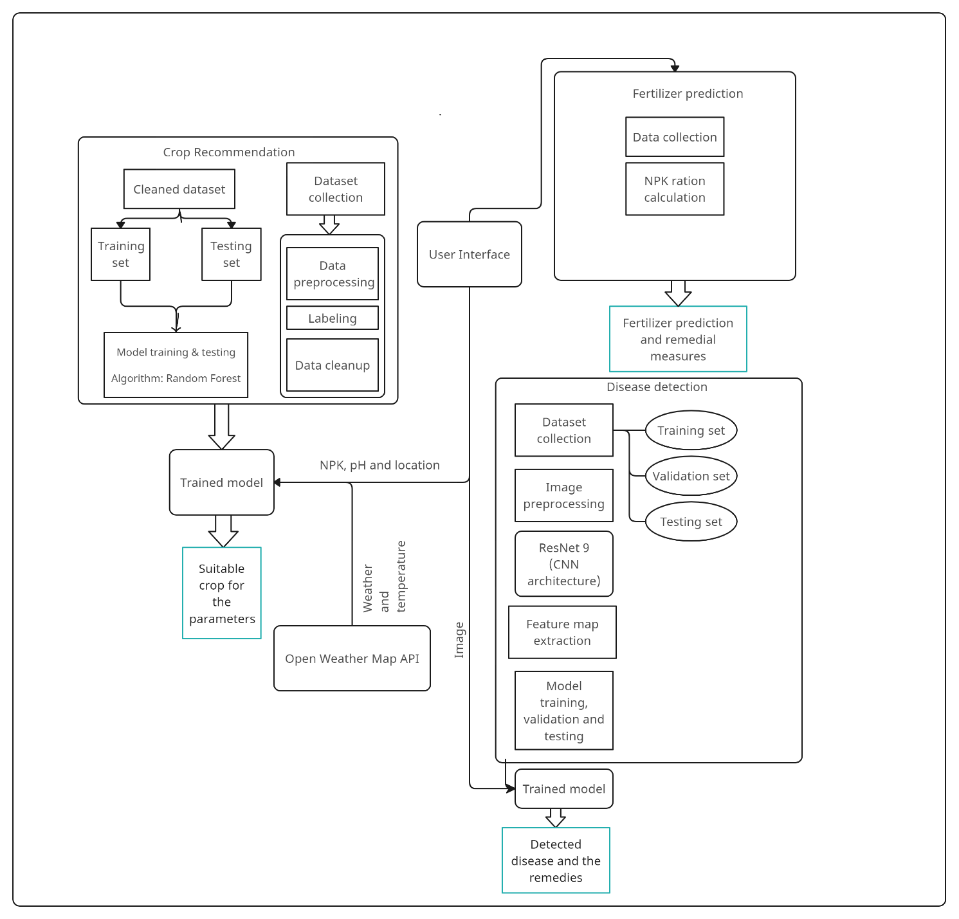
SYSTEM ARCHITECTURE
2019

Slide 18
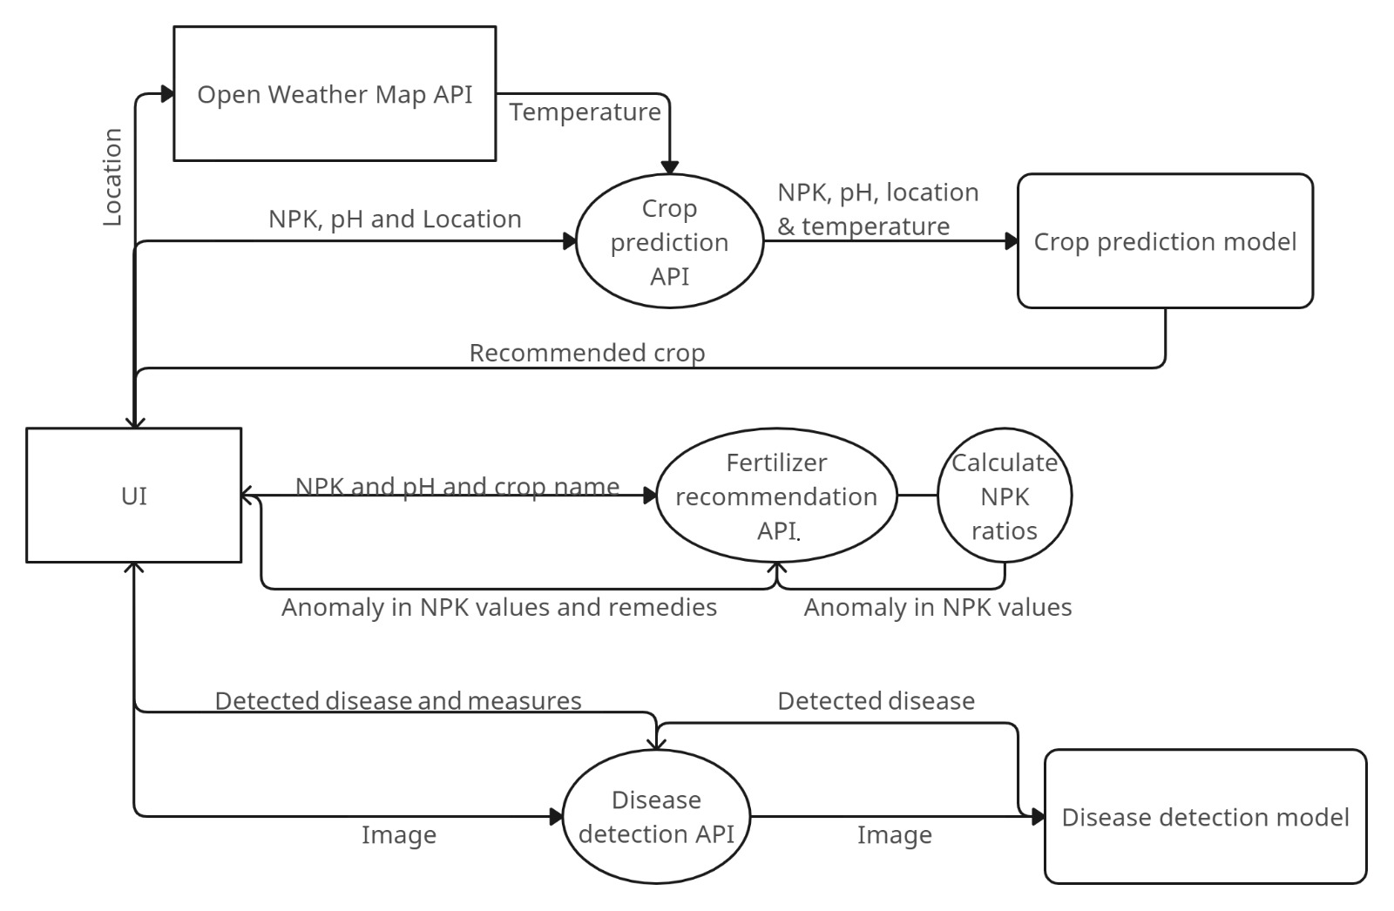
DATA FLOW DIAGRAM
2019

Slide 19
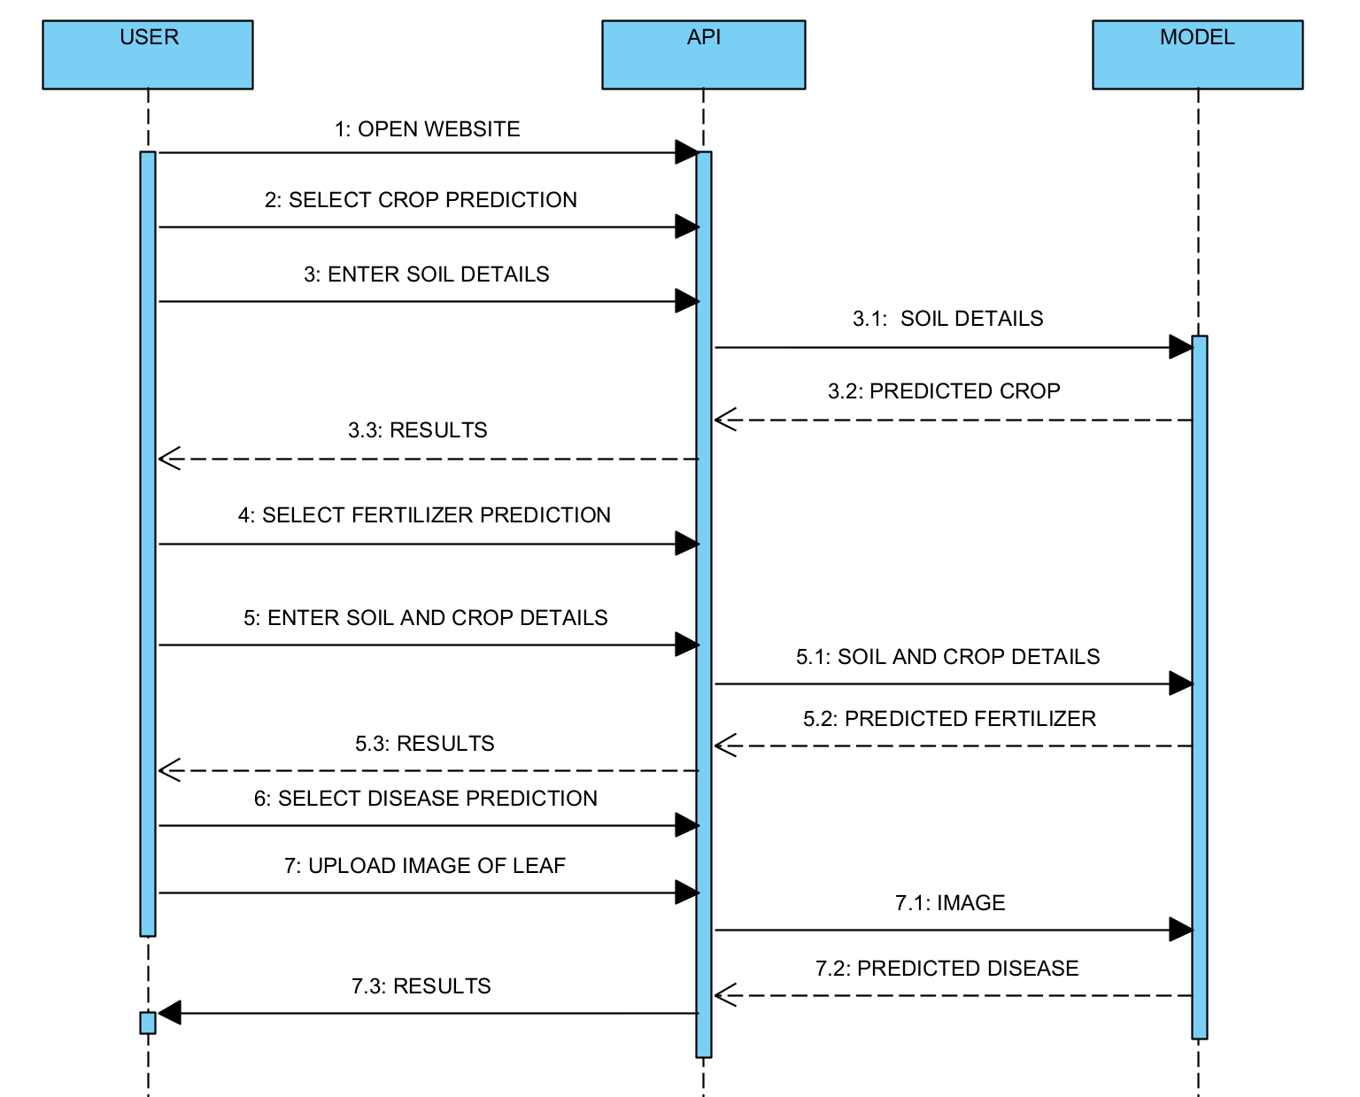
SEQUENCE DIAGRAM

Slide 20
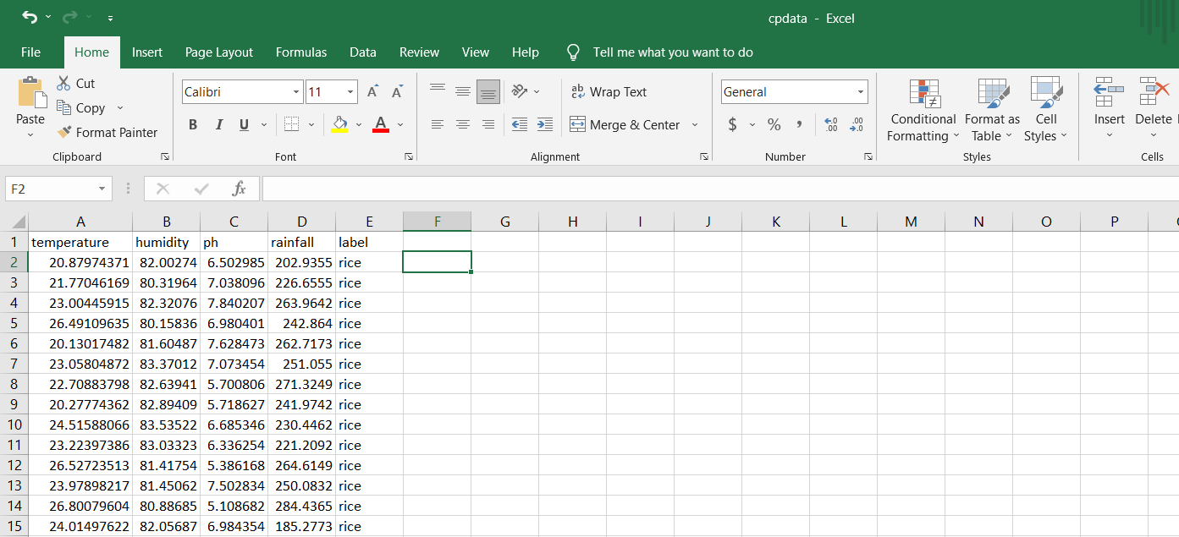
FOR TRAINING THE CROP PREDICTION MODEL TEMPERATURE, HUMIDITY, PH, RAINFALL ARE USED. IT IS COMBINED ALONG WITH THE DATA SET USED FOR FERTILIZER PREDICTION. FOR FERTILIZER PREDICTION MODEL TRAINING AND TESTING, CUSTOM DATA SETS WITH FIVE FIELDS CROP NAME, NITROGEN, PHOSPHORUS, POTASSIUM, AND PH LEVEL. DATA SETS FOR DISEASE DETECTION MODEL ARE COLLECTED FROM IMAGENET OPEN SOURCE LIBRARY. THE IMAGENET DATASET IS A VERY LARGE COLLECTION OF HUMAN ANNOTATED PHOTOGRAPHS DESIGNED BY ACADEMICS FOR DEVELOPING COMPUTER VISION ALGORITHMS.
DATA
COLLECTION

Slide 21
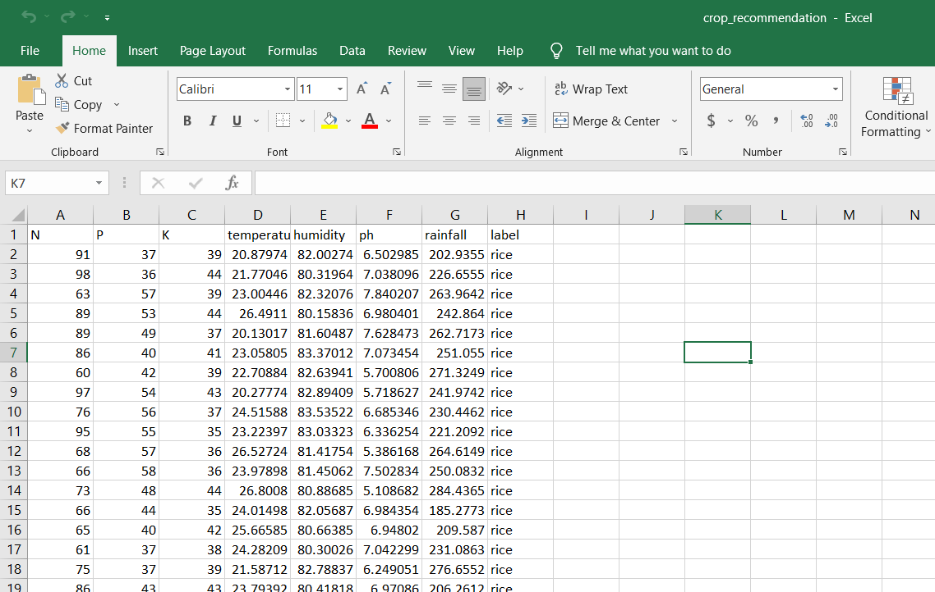
DATA
PRE-PROCESSING
FOR THE CROP PREDICTION MODEL, THE ORIGINAL DATA SET IS COMBINED WITH THE FERTILIZER PREDICTION AND NOISY DATA IS REMOVED AND THEN THE DATA SET IS LABELED. THE PREPROCESSED DATA SET WILL CONTAIN THE FOLLOWING FIELDS.
Nitrogen
Phosphorus
Potassium
Temperature
Humidity
pH
Rainfall
LABELS

Slide 22
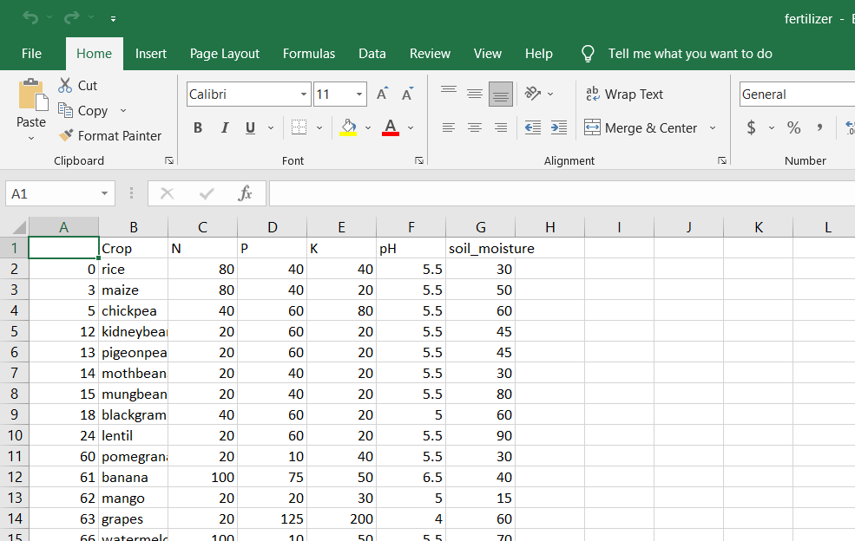
DATA
PRE-PROCESSING
FOR FERTILIZER PREDICTION AFTER PREPROCESSING THE DATA, A NEW COLUMN FOR SOIL MOISTURE IS ADDED AND IRRELEVANT AND NOISY DATA ARE REMOVED USING PANDAS.
The preprocessed data set will contain the following fields.
Crop
Nitrogen
Phosphorus
Potassium
pH value
Soil moisture

Slide 23
FEATURE EXTRACTION
MODEL TRAINING AND TESTING
FOR THE IMAGES, THE TORCHVISION.MODELS.FEATURE_EXTRACTION PACKAGE CONTAINS FEATURE EXTRACTION UTILITIES THAT LETS US TAP INTO OUR MODELS TO ACCESS INTERMEDIATE TRANSFORMATIONS OF OUR INPUTS(IMAGES). THIS IS USED TO CONVERT A PIL IMAGE OR NUMPY ARRAY TO TENSOR. IT CONVERTS A PIL IMAGE OR NUMPY.NDARRAY (H X W X C) IN THE RANGE [0, 255] TO A TORCH.FLOATTENSOR.
THE MODEL IS TRAINED AND TESTED. SPLITTING THE DATASET BY 80 % FOR THE TRAINING SET AND 20 % VALIDATION SET. THE ACCURACY OF EACH MODEL IS THEN CALCULATED AND COMPARED USING TESTING DATA TO DISCOVER THE BEST MODEL FOR THE DATASET. A USER INTERFACE IS BUILT WHICH WILL DISPLAY THE PREDICTION USING THE STORED TRAINING DATA.

Slide 24
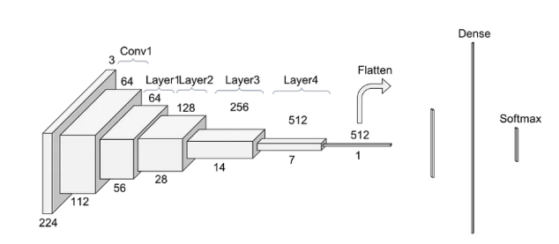
RESNET9
OF CNN
ResNet9 works by taking an input image and passing it through a series of layers in the neural network. These layers are designed to extract different features from the image, such as edges, shapes, and textures. The key innovation of ResNet9 is the use of residual connections between layers. These connections allow information to flow directly from one layer to another, bypassing intermediate layers. This helps to prevent the vanishing gradient problem, which can occur when trying to train very deep neural networks. ResNet9 leverages a technique called convolution to extract features from images.
(CNNs) utilize small filters that slide over an input image to detect different features and patterns. The output of each filter is a feature map that emphasizes a specific aspect or component of the image. These feature maps, which represent the input image, visually display where particular features or patterns were identified by the CNN's filters. Later layers in the network then integrate these feature maps to produce more abstract representations of the image, ultimately enabling accurate image classification.

Slide 25
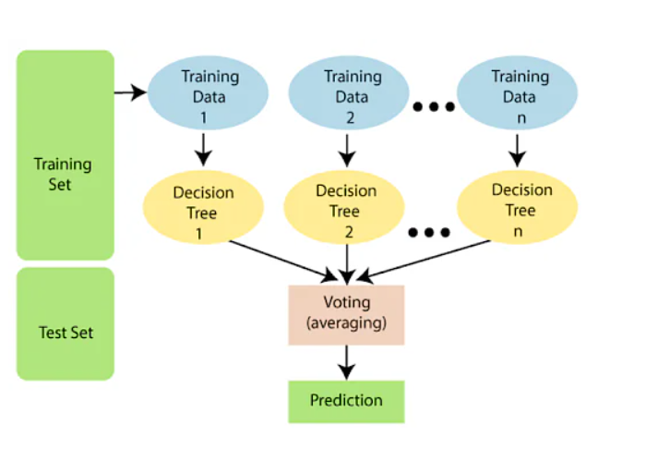
A RANDOM FOREST ALGORITHM IS A SUPERVISED MACHINE LEARNING ALGORITHM WHICH IS EXTREMELY POPULAR AND IS USED FOR CLASSIFICATION AND REGRESSION PROBLEMS IN MACHINE LEARNING.
The following steps explain the working Random Forest
Algorithm:
Step 1: Select random samples from a given data or training set.
Step 2: This algorithm will construct a decision tree for
every training data.
Step 3: Voting will take place by averaging the decision tree.
Step 4: Finally, select the most voted prediction result as the
final prediction result.
RANDOM FOREST

Slide 26

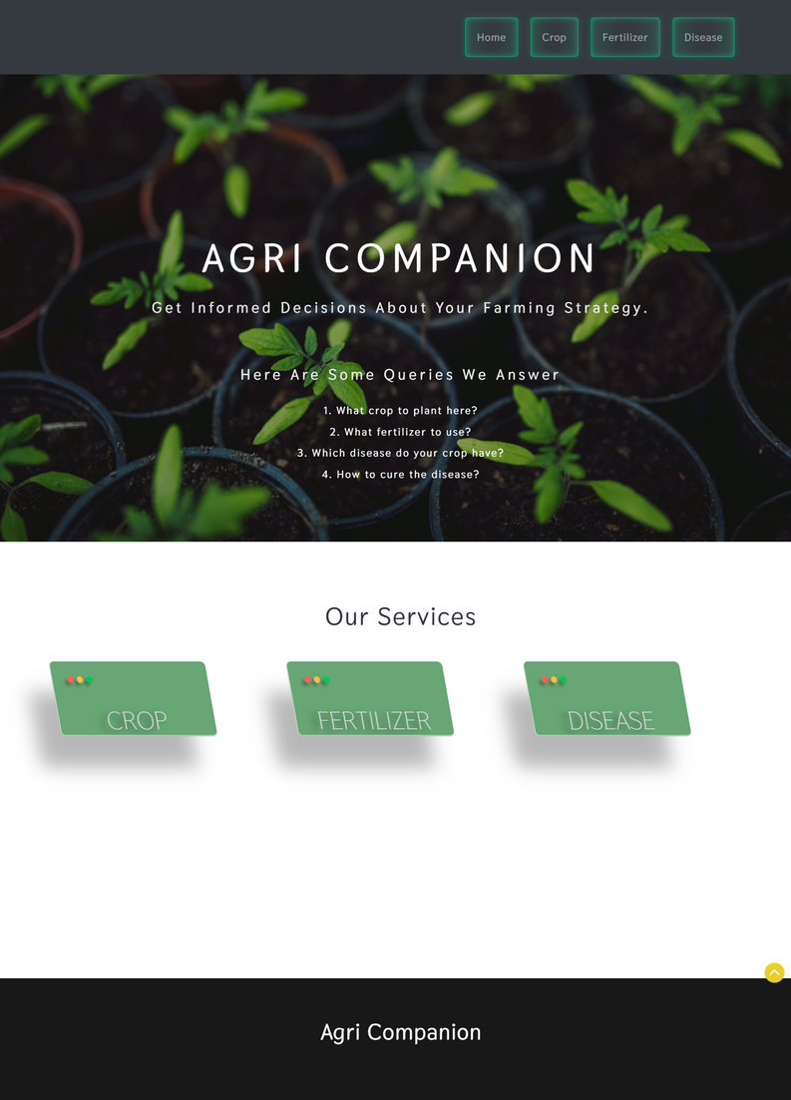
INPUT DESIGN

Slide 27
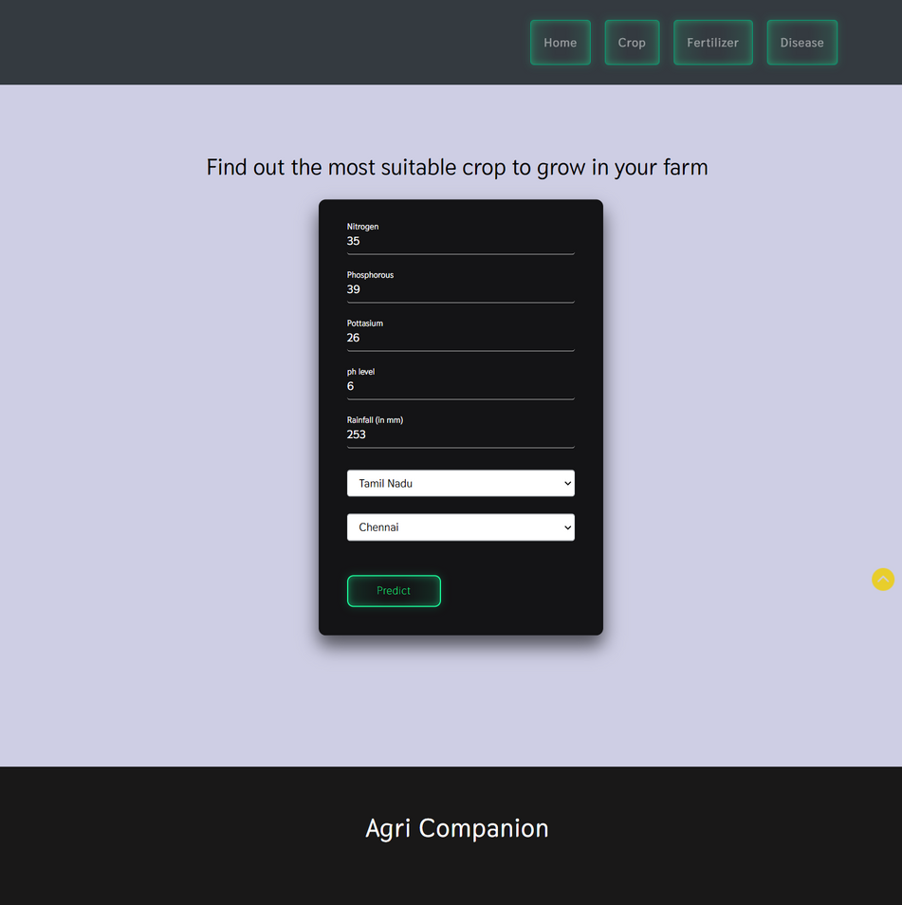
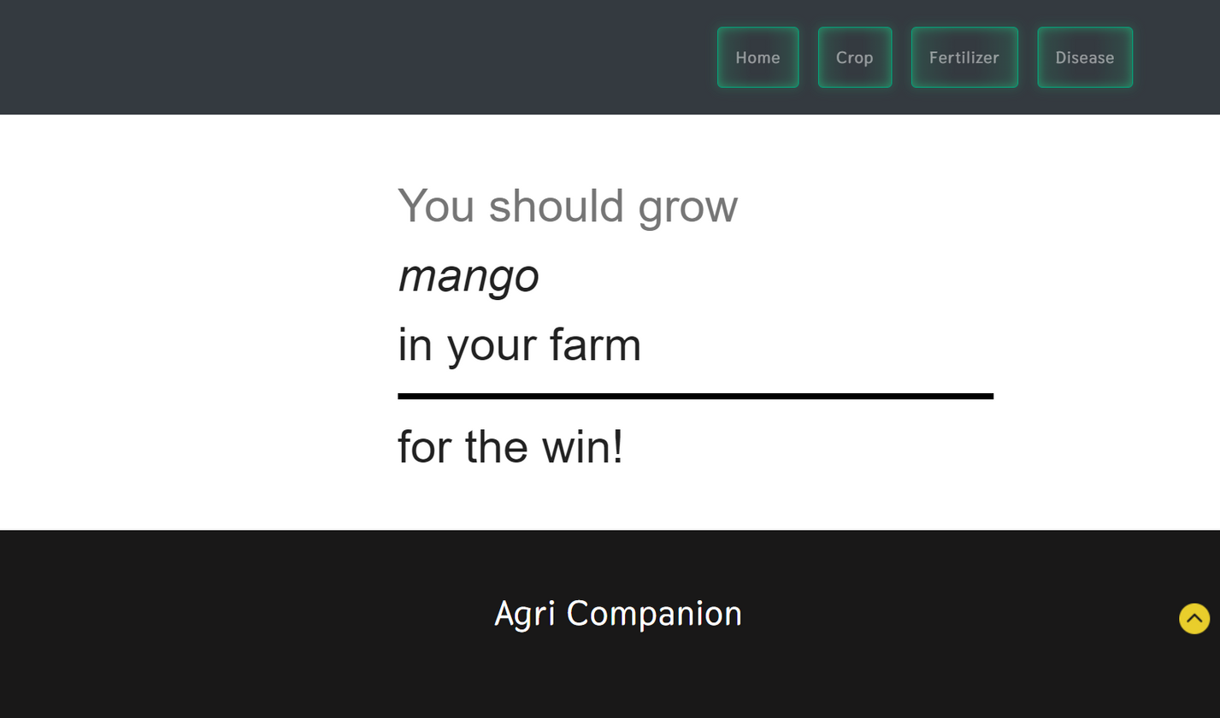
INPUT DESIGN

Slide 28
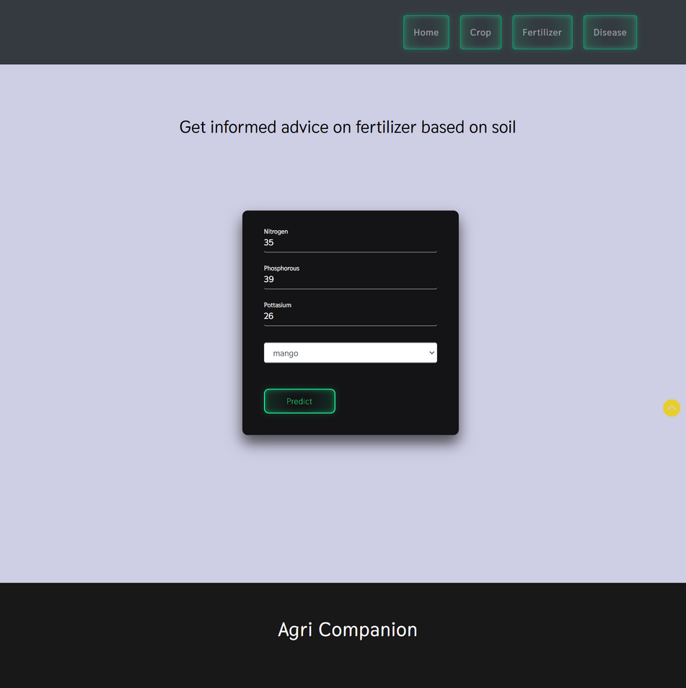
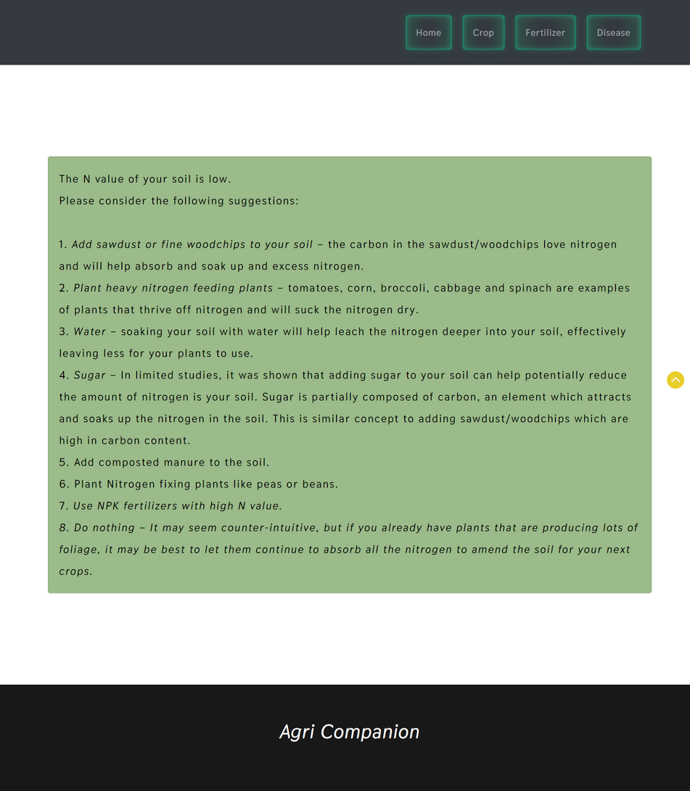
INPUT DESIGN

Slide 29
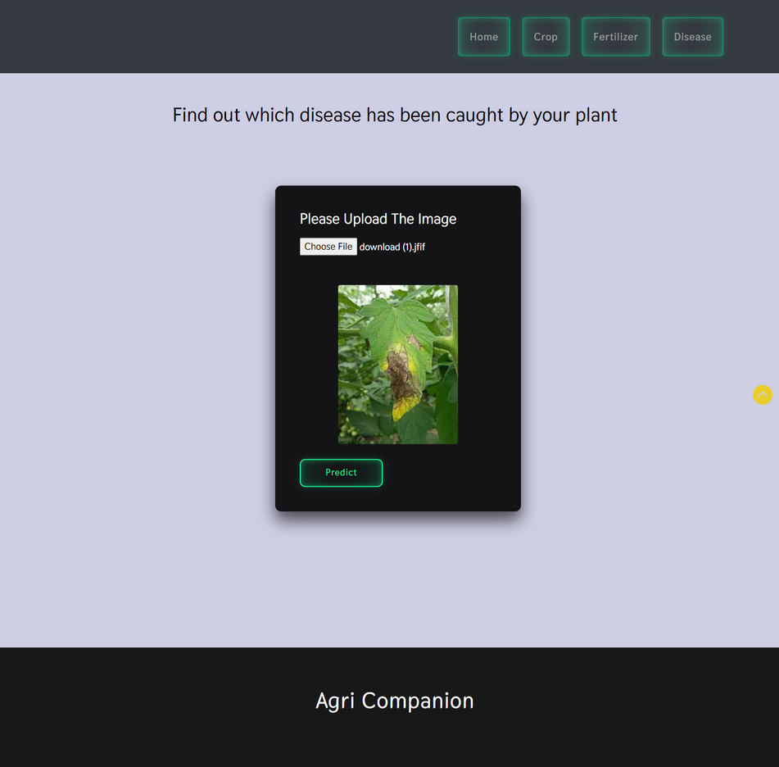
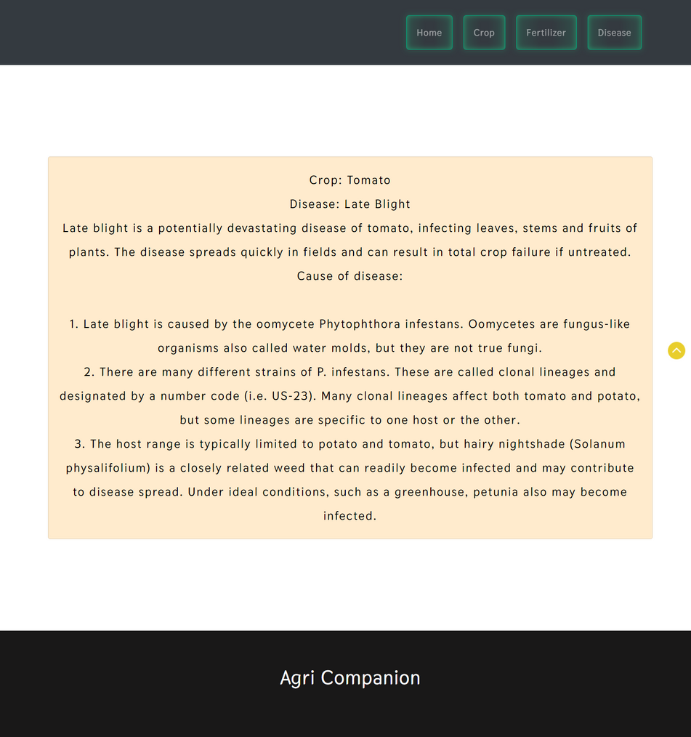
INPUT DESIGN

Slide 30

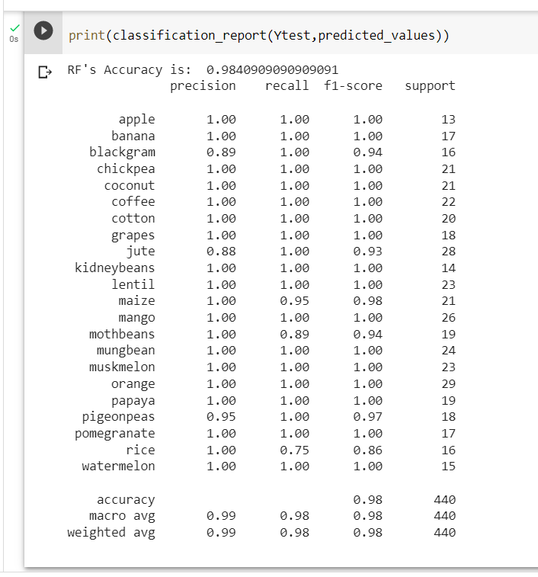
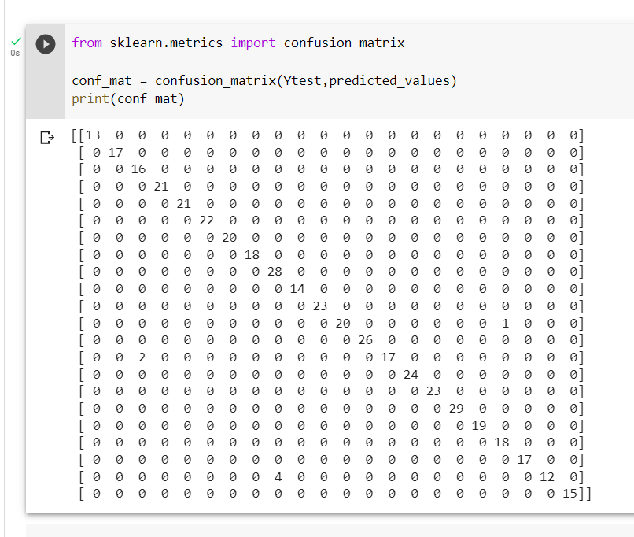
PERFORMANCE METRICS
FOR THE CROP PREDICTION MODEL USING RANDOM FOREST, THE CALCULATED ACCURACY IS 98.409%.
THE PRECISION AND F1 SCORE FOR ALL THE CLASSES ARE GIVEN AS FOLLOWS

Slide 31
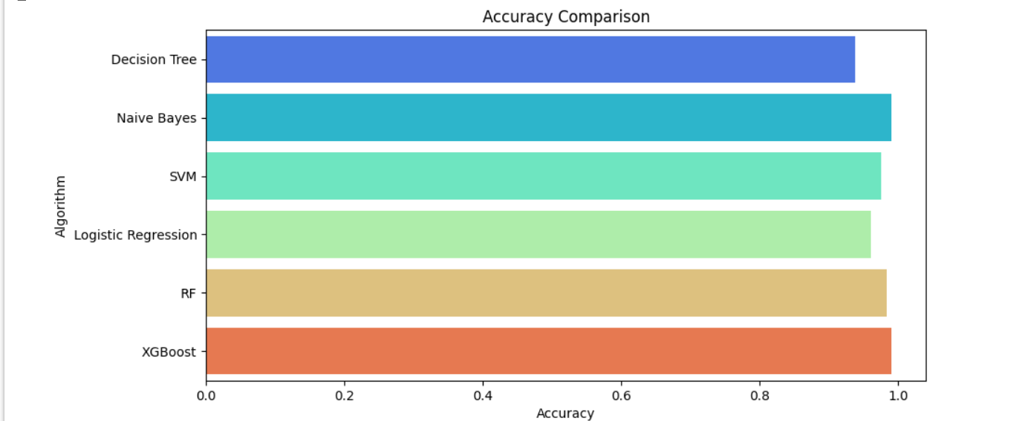
COMPARATIVE ANALYSIS
S.No | ALGORITHM | ACCURACY
1. | Decision Tree | 90.00%
2. | Gaussian Naive Bayes | 99.09%
3. | Support Vector Machine (SVM) | 97.95%
4. | Logistic Regression | 95.23%
5. | Random Forest | 99.09%
6. | XG Boost | 99.02%
THE COMPARITIVE ANALYSIS IS AS GIVEN AS FOLLOWS FOR ALL THE ALGORITHMS.
Of all, GAUSSIAN NAÏVE BAYES & RANDOM FOREST have proved to be more accurate for the given problem and the dataset

Slide 32
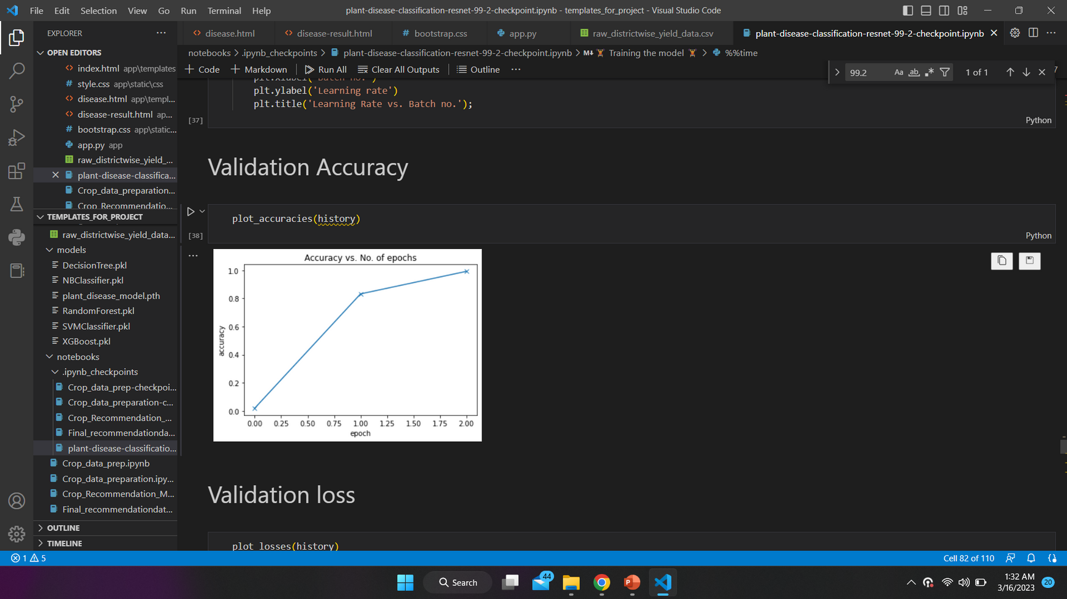
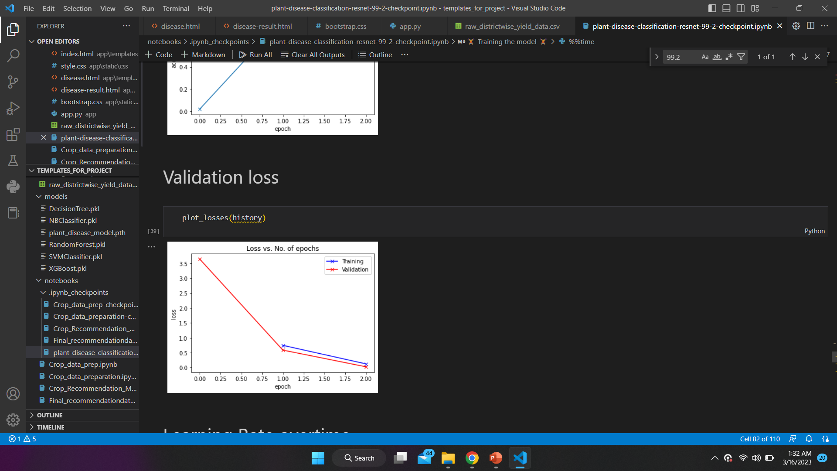
PERFORMANCE METRICS
THE VALIDATION SCORE AND THE VALIDATION LOSS FOR THE CNN MODEL ARE AS FOLLOWS
AN ACCURACY OF 99.2% HAS BEEN ACHIEVED FOR THE VALIDATION SET

Slide 33
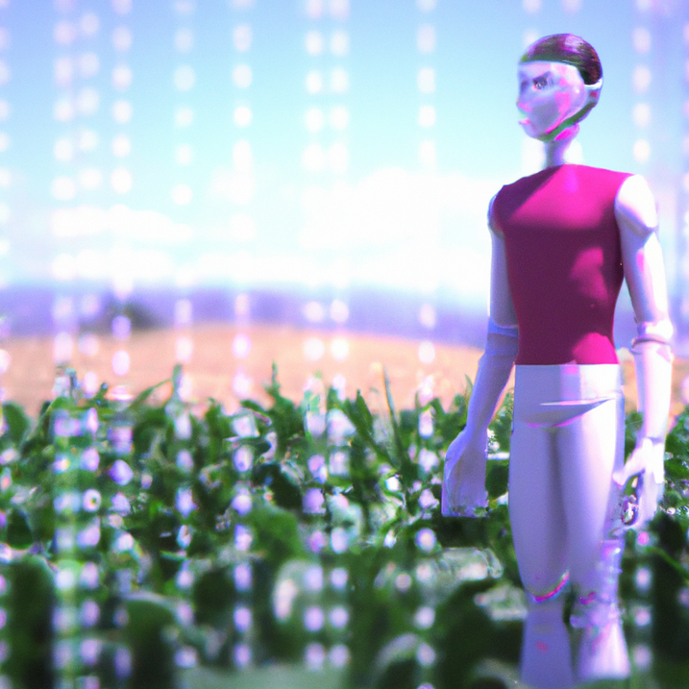
CONCLUSION
As farming is a significant component of our economy, it is crucial to make sure that even the smallest investment made in the agriculture industry is taken care of. Crop seeds are one such investment. So, it is crucial to confirm that the right crop has been selected for the right soil and that it meets its criteria in order to benefit the farmer. With the use of this technology, farmers would be better able to choose the right crop to plant based on a range of geographical and environmental parameters. By integrating perception and passed-down knowledge with a significantly more dependable solution to a significant problem affecting hundreds of millions of people, the ML and IoT assist them in minimizing costs and making strategic decisions. The next intention is to expand the number of soil variables and the size of the data set for this model in future work.

Slide 34

FUTURE SCOPE
A higher crop production is achievable, as evidenced by the forecast of crop yield based on soil data and effective algorithm implementation. The following features can be included by expanding the work. By uploading agricultural images, creating a website can assist farmers. Image processing is used to detect crop diseases so that users can order pesticides based on disease images and forecast fertilizer needs based on the state of the soil. By offering necessary guidance on crops, their development, and other fundamental knowledge, technology will help farmers. The address of the closest store where farmers may buy fertilizer and other supplies will also be provided. By giving them precise data on market prices and merchant information, it would also help farmers sell their goods to retailers. Also, this application can aid farmers in calculating crop MSP. Using the Internet of Things, the disease detection feature can be expanded (IOT TECHS).

Slide 35
REFERENCES
1.ABHINAV SHARMA, ARPIT JAIN, PRATEEK GUPTA AND VINAY CHOUDARY ”MACHINE LEARNING APPLICATION FOR PRECISION AGRICULTURE” PUBLISHED IN IEEE ACCESS, VOLUME 09, (2020)
2. Dayalini S, Sathana M, Navodya P.R.N, Narmada Gamage, Anuradha Jaya “Agro-Mate: A Virtual Assister to Maximize Crop Yield in Agriculture Sector”, Published in IEEE Region 10 Conference(TENCON), 2021.
3. Sanidhya Purohit, Deep Sanghani. Naman Senjaliya, Prof. Anuradha Kapoor, “Agro-Farm Care for Crop, Fertilizer & Disease Prediction using Machine Learning”, Published in International Research Journal of Engineering & Technology, Volume: 09, 2022.
4. Priyanka Sahu, Amit Prakash Singh, Anuradha chug,Dinesh Singh,“A Case Study of Banana Crop using Machine Learning”, Published in IEEE Region 10 Conference (TENCON), 2022.
5. Arfat Ahmad khan, Muhammad Faheem, Rab Nawaz Bashir,Muhammad Zahid Abbas, “IOT Assisted Context Aware Fertilizer Recommendation” , Published in IEEE Access, Volume 10, 2022.

Slide 36
REFERENCES
6. PE RUBINI, P KAVITHA, “DEEP LEARNING MODEL FOR EARLY PREDICTION OF PLANT DISEASE”, PUBLISHED IN THIRD INTERNATIONAL CONFERENCE ON INTELLIGENT COMMUNICATION TECHNOLOGIES AND VIRTUAL MOBILE NETWORKS, 2021.
7. Sri Laasya.Kanuru,Amit Kumar Tyagi,Aswathy S UN Sreenath,Terrance Frederick Fernandez,Shashvi Mishra, “Prediction of Pesticides and Fertilizers using Machine Learning and Internet of Things”, Published in International Conference on Computer Communication and Informatics (ICCCI ), 2021.
8. Anguraj.K, Thiyaneswaran.B, Megashree. G, Preetha Shri.J.G, Navya.S, Jayanthi.J, “Crop Recommendation on Analyzing Soil using Machine Learning”, Published in Turkish Journal of Computer and Mathematics Education, Volume 12, 2021.
9. Taranjeet Singh, Saurabh Anand, Anmol Sehgal, Siddhesh Mahajan, Prof. Pranoti Kavimandan, “CROFED - Crop and Fertilizer Recommendation and Disease diagnosis system using Machine Learning and Internet of Things”, Published in, Volume 09, 2022.
10. C.Murugamani,,S.Hemalatha,Pravin R.Kshirsagar,K.Riyazuddin, Quadri Noorulhasan Naveed, Saiful Islam, S.Siddharth, Syed Parween Mazher Ali, & Areda Batu, “Machine Learning Technique for Precision Agriculture Applications in 5G-Based Internet of Things”, Published in Wireless Communications and Mobile Computing Volume, 2022.

Slide 37
THANK YOU

Slide 38

LITERATURE SURVEY

Slide 39
From the above papers, it has been inferred that in most cases the data collection has been done using IOT to get real time data.
In most of these cases, the data set focusses on either one of the crops or from a certain region.
SUMMARY
It has been inferred that the IoT devices used for the analysis of soil is not very efficient and has to be made feasible so that it can be accessed easily.

Slide 40

IN THE EXISTING SYSTEM, THE APPLICATION HAS BEEN DEVEPED IN ORDER TO PREDICT THE CROPS FOR ONLY ONE REGION OR FOR A FEW TYPES OF OR LOOPS ONLY.
DATA COLLECTION HAS BEEN DONE REAL TIME USING IOT BUT ONLY FOR A SPECIFIC REGION HAS BEEN CONSIDERED.
IN SOME CASES ONLY CERTAIN FUNCTIONALITIES HAVE BEEN IMPLEMENTED. EITHER CROP RECOMMENDATION OR FERTILIZER PREDICTION OR DISEASE DETECTION.
EXISTING SYSTEM

Slide 41

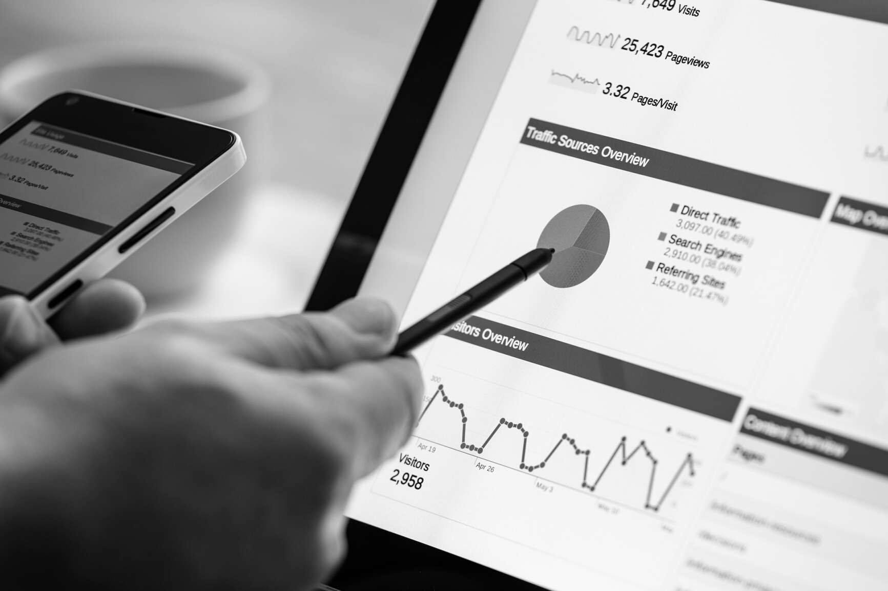

CROP PREDICTION
NPK VALUES
+
PH
+
RAINFALL
+
LOCATION
CROP
FERTILIZER PREDICTION
NPK VALUES
+
CROP TO BE GROWN
FERTILIZER AND PREVENTIVE MEASURES
OUR SERVICES
DISEASE DETECTION
IMAGE OF
INFECTED
PLANT
DISEASE AND SUITABLE
MEASURES

Slide 42
MODULES
DATA COLLECTION
DATA PREPROCESSING
FEATURE EXTRACTION
MODEL TRAINING AND TESTING

Slide 43
TECHNICAL FEASIBILITY :
The various technical resources such as dataset and the correct IDE’s, GPUs for training the model, etc are available and are made use of them efficiently. The various libraries, packages and APIs are open-source and are easy to use to manipulate data.
SOCIAL FEASIBILITY :
Agri Companion helps the Farmers to increase the crop yield and fertilizer prediction by recommending a suitable crop and fertilizer for their land with the help of geographic and climatic parameters. The proposed system is found to be effective. Detection of plant diseases through the proposed system is beneficial as it reduces a large amount of work of monitoring in big farms of crops and at the early stage itself the farmer can detect the symptoms of disease i.e., when they appear on plant leaves. Thus, the identification of nutrient deficiency is helpful to farmers for proper monitoring of crop growth and optimum usage of fertilizers. Also, it will encourage farmers and promote fair trade. The work should be planned to specifically address the needs of farmers, taking into account their socioeconomic level, the size of their farms, and their farming methods. The suggestions need to be applicable, pertinent, and suitable for the local circumstances
FEASIBILITY
STUDY

Slide 44
ALGORITHM
EXPLANATION

Slide 45
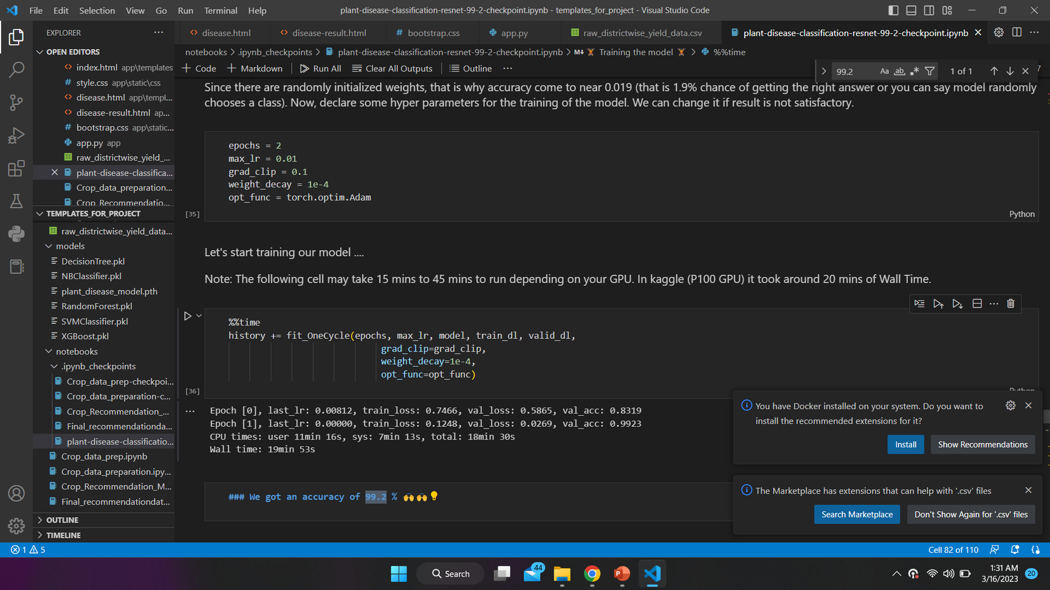
PERFORMANCE METRICS
FOR THE CNN MODEL AN ACCURACY OF 99.2 IS ACHIEVED

